Slide 1
Training Deep Neural Nets
Varol Kayhan, PhD

Slide 2
Recall: Deep Neural Networks
Layer 1
Layer 2
Layer 3
Input layer
Output layer
Hidden layers

Slide 3
Recall: Deep Neural Networks
How to build deep neural networks?
TensorFlow
Keras (high level API)
Build your own neurons and architecture (low-level API)

Slide 4
What Will We Cover?
How can we train DNNs?
So that they are accurate and use less resources
What are some of the hyperparameters?
Both low- and high-level

Slide 5
Imagine…
10s or 100s of hidden layers
100s of neurons in each layer
Thousands/millions of weights and biases
Problems:
Vanishing/exploding gradients
Slow training
Overfitting

Slide 6
Vanishing/Exploding Gradients
Feedforward network
Layer 1
Layer 2
Layer 3
Input layer
Output layer
Hidden layers
Backpropagation

Slide 7
Vanishing/Exploding Gradients
Vanishing gradients:
Gradients gets smaller as the algorithm reaches lower layers
Lower layer weights remain unchanged
Solution never converges
Exploding gradients:
Gradients grow bigger and bigger
Large updates to weights
Solution diverges

Slide 8
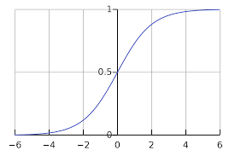
Vanishing/Exploding Gradients
A research paper published in 2010 identified the suspects!
Two main reasons:
Use of logistic (sigmoid) function as activation
Random initialization of weights and biases

Slide 9




Xavier (Glorot) Initialization
“The variance of each layer's output should be equal to the variance of its inputs”
“Gradients should have the same variance before flowing in reverse”

Slide 10


Xavier (Glorot) Initialization
Initialize the connection weights using:
This led to the current success of Deep Learning!
This is the default setting in Tensorflow:
tf.keras.layers.Dense()

Slide 11
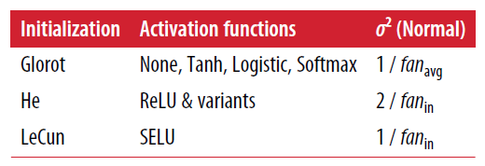
Other Initializations

Slide 12
Initializations…
Will we use it to train DNNs?
Why not…?
Or, use default settings

Slide 13
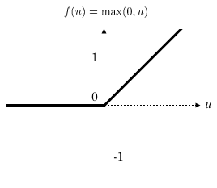
Nonsaturating Activation Functions
Vanishing/exploding gradient happens because of logistic (sigmoid) activation function.
Solution: ReLU
Doesn't saturate for positive values
Fast to compute
Problem: it leads to "dying" neurons
Certain neurons start producing 0s
If the weighted sum of a neuron's inputs is <0, the output is always 0

Slide 14
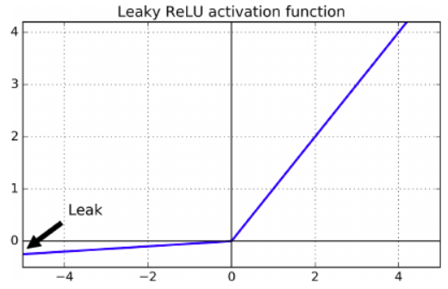
Nonsaturating Activation Functions
Solution: Leaky ReLU
Small slope for <0 makes sure a neuron doesn't "die"
It produces a value close to 0, but may eventually "wake up"
In tests, leaky ReLU performs better than ReLU
Implementation: (add as a “layer”)
tf.keras.layers.LeakyReLu(alpha=0.2) (alpha is a measure of how much the function leaks)

Slide 15
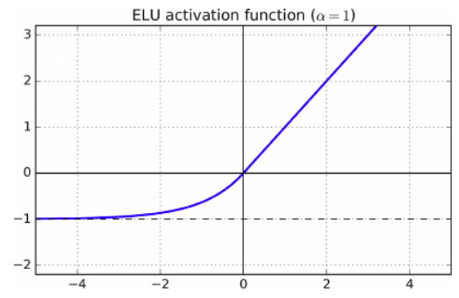
Nonsaturating Activation Functions
Another solution: ELU (exponential linear unit)
Negative values when <0 help with vanishing gradient
None-zero gradient avoids dying neurons
Slope is 1 when >0, which speeds up gradient descent
Drawback: slower than ReLU and its variants!
Advantage: faster convergence rate

Slide 16
Nonsaturating Activation Functions
Another solution: SELU (scaled exponential linear unit)
A stack of Dense layers, with SELU activation:
Network will self-normalize
Solves vanishing/exploding gradients problem
Can outperform other activation functions
Conditions for success:
Standardize all inputs
Use: kernel_initializer = “lecun_normal”
Use sequential models only (no wide & deep networks)
Use only Dense layers

Slide 17
Which Activation to Use?
Can use "ReLU" in most cases
Use "softmax" function at output layer if multi-class
Use "sigmoid" function at output layer if binary classification
Do not use a function at output layer if regression

Slide 18
Which Activation to Use?
In general: SELU> ELU > Leaky ReLU > ReLU > tanh > logistic
Will we use different activation functions to train DNNs?
Sure…
They make a substantial difference!

Slide 19
Batch Normalization
Another solution to vanishing/exploding gradients
Works better for deeper networks (specifically for processing images)
Becoming one of the most commonly used layers in deep networks
Generate the “optimal scale” and “mean” of inputs for each layer:
Right before activation, zero-center and normalize the inputs
Then, scale and shift the results
If you use it as the first layer of the network, no need to standardize your training data set ()

Slide 20
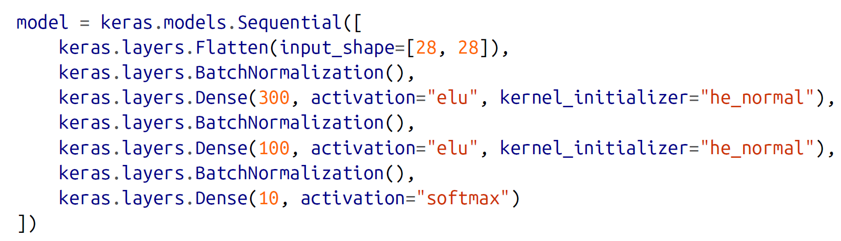
Batch Normalization
If batch normalization is used, experiments show:
No need to standardize inputs in the training data (it will do batch-by-batch)
Networks are not sensitive to initialization
Can use much larger learning rates (so learns much faster)
Acts as a regularization technique (no need to use dropout layers)
Slower training (due to new computations in each layer)
Performed as follows:

Slide 21
Batch Normalization
Will we use it to train DNNs?
Not likely
Use default settings

Slide 22
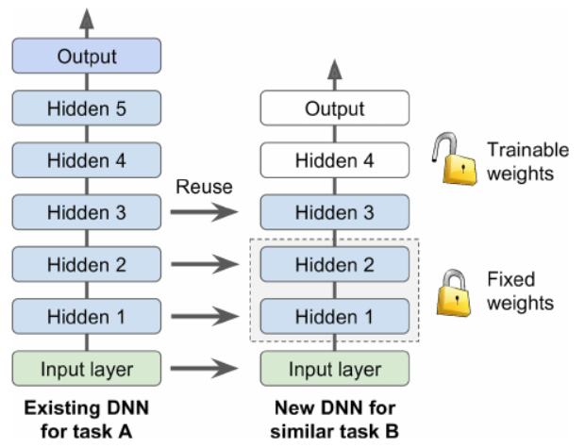
Reusing Pretrained Layers
Can't train large DNNs always from scratch
Find an existing DNN, reuse lower layers
Called transfer learning
Example: a DNN that classified 100 different categories
Reuse lower layers to build a DNN for specific vehicle types

Slide 23
Where to Find Existing DNNs?
TensorFlow's model zoo (https://github.com/tensorflow/models)
Caffe's model zoo (https://github.com/ethereon/caffe-tensorflow)
Tricky to do!!!
Performance gets worse before it gets better
Requires lots of fine-tuning

Slide 24
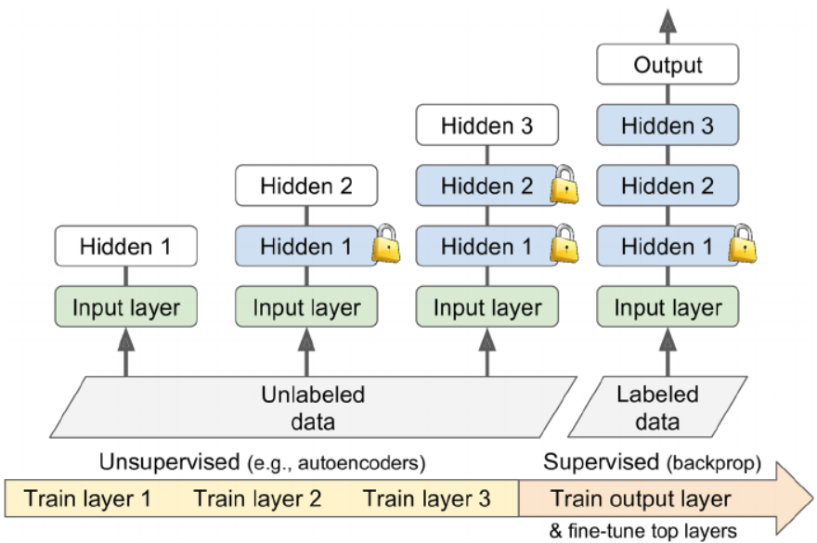
Unsupervised Pretraining
What if you don't have much labeled data?
Lower layers use an unsupervised feature detector (like autoencoders)
Upper layers use supervised learning

Slide 25
Unsupervised Pretraining
Example: face detection with only a few pictures per person
Gather lots of pictures of random people (unlabeled)
Train first DNN: learn good feature detectors for faces
Add higher layers for supervised learning

Slide 26
Recap…
What can we do to train “better” and “faster” neural networks?
Initialization
SELU, ELU, or ReLU activation functions
Batch normalization
Use pretrained layers
How about selecting a good optimizer?

Slide 27
Optimizers
So far, we have seen Gradient Descent
Are there other faster/better optimizers?
Momentum
Nesterov Accelerated Gradient
AdaGrad
RMSProp
Adam

Slide 28
Momentum Optimization
Roll down a steel ball in a bowl
Starts slowly, but reaches terminal velocity toward bottom
In contrast, Gradient Descent takes regular steps
If gradient is high, takes big steps
If gradient is low, takes smaller steps
So, optimization takes longer as it goes from high to low
Momentum uses gradient as "acceleration" not speed

Slide 29
Momentum Optimization
A value between 0 (high friction) and 1 (no friction)
Typical value is 0.9 (this makes it 10 times faster than Gradient Descent)
Can escape plateaus much faster
Can get past local optima

Slide 30
Nesterov Accelerated Gradient
A faster variant of momentum optimizer
Measures the gradient a little farther than plain momentum
Reaches optimum faster

Slide 31
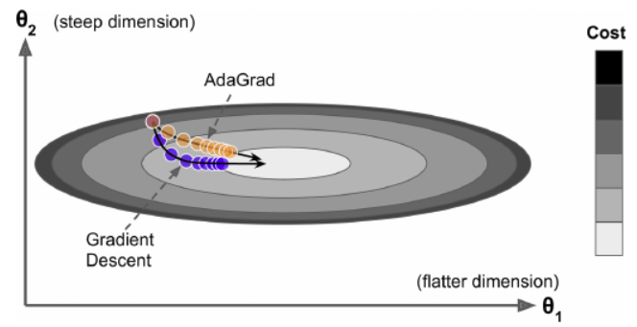
AdaGrad
Adaptive Gradient
Instead of rolling down the hill, detect steepest slope, then point straight at the global optimum

Slide 32
AdaGrad
Works well for quadratic problems
Stops early for neural networks (so not recommended for DNNs)
Keras has AdaGrad, but it is not recommended for use

Slide 33
RMSProp
Uses exponential decay (so gradients only from the last iteration are used)
This prevents slowing down (like AdaGrad)
The decay value is usually set to 0.9

Slide 34
Adam and Nadam
(Nesterov) Adaptive Moment Estimation
Combines Momentum and RMSProp
Hyperparameters:
Momentum decay: 0.9 (typical value)
Scaling decay: 0.999 (typical value)
Smoothing term: a very small number (10⁻⁸)
Can use a small learning rate (0.001)
There is an AdaMax version as well

Slide 35
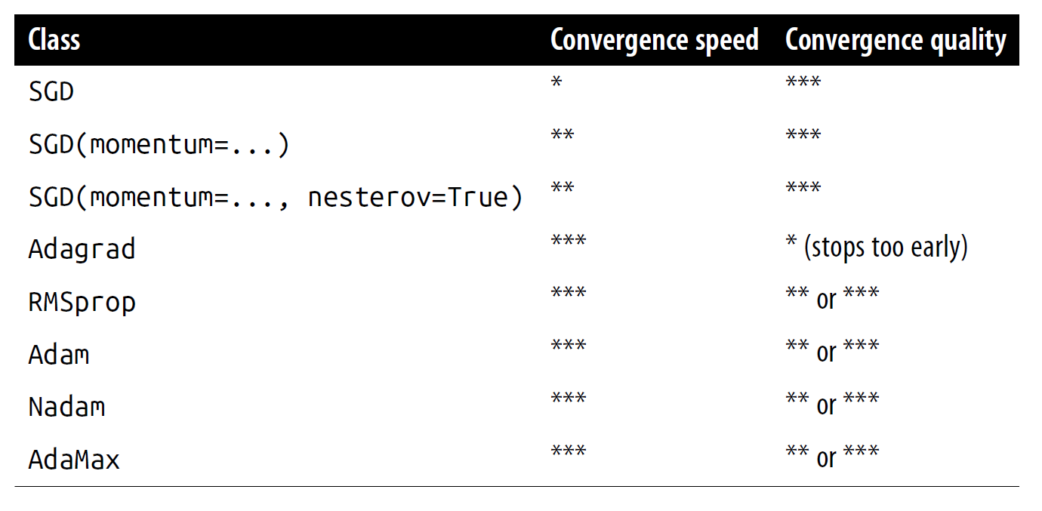
Which Optimizer to Use
Will we use different optimizers to train DNNs?
Absolutely!!!
They make a substantial difference!

Slide 36
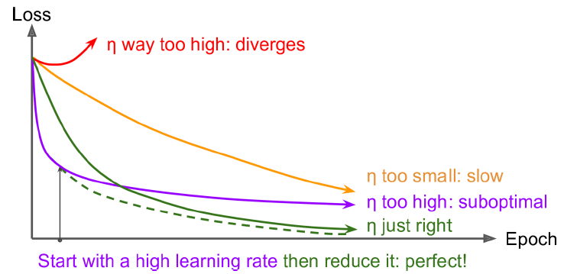
Learning Rate Scheduling
High learning rate can cause diverging solution
Low learning rate can take too long

Slide 37
Learning Rate Scheduling
What about changing the learning rate during training!
0.1 for 50 epochs, then 0.001 afterwards
OR: measure error every N steps, reduce learning rate by a factor
OR: set the learning rate to a function of the iteration number
OR: power scheduling to reduce the learning rate slowly
Power scheduling is easiest: set the “decay” option
Decay: the inverse of the number of steps it takes to divide the learning rate by one more unit

Slide 38
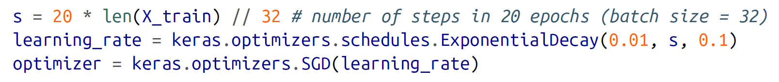
Learning Rate Scheduling
You can also built-in Keras schedulers:

Slide 39
Learning Rate Scheduling
Will we use learning rate scheduling to train DNNs?
Absolutely!!!
They make a substantial difference!

Slide 40
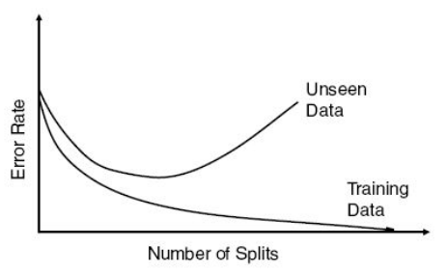
Avoid Overfitting: Early Stopping
Measure both train and validation error
Stop when validation error increases
Validation
Data
Number of iterations

Slide 41
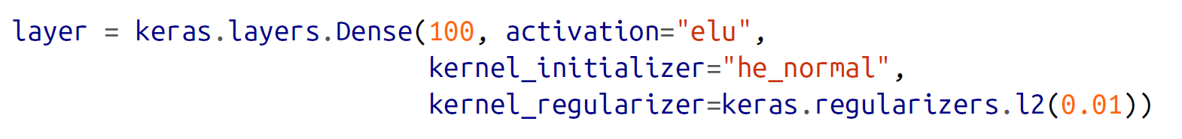
Avoid Overfitting: L1 and L2 Reg.
Use L1 and L2 regularization to constrain the weights of neurons
Implementation is easy:
Swap l2 with l1 if you want to do L1.
Swap l2 with l1_l2 if you want to do both

Slide 42
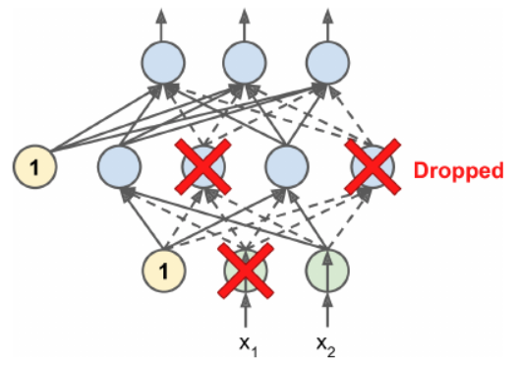
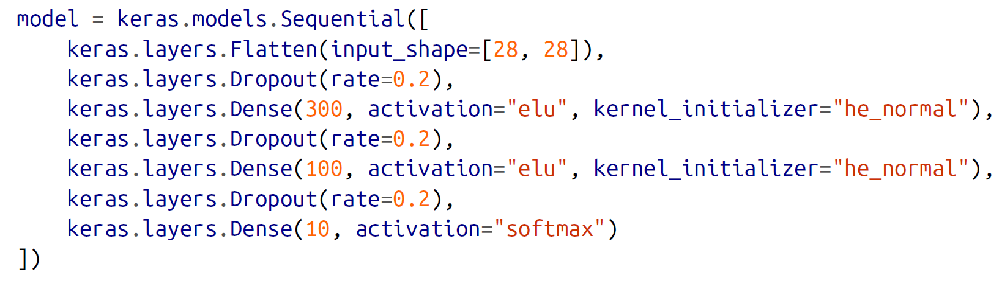
Avoid Overfitting: Dropout
Can increase accuracy by 1-2%
At every training step, each neuron has a probability of p of being ignored during training
A dropped neuron in the current step can be active in the next step
Easy to implement:

Slide 43
Avoid Overfitting
Will we use overfitting prevention to train DNNs?
Absolutely!!!

Slide 44
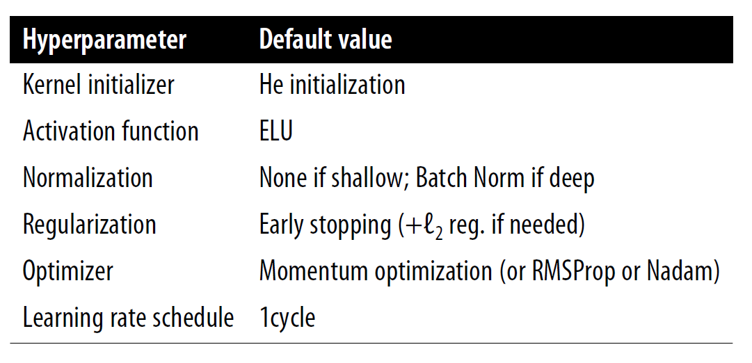
Practical Guidelines
Book recommendations:
Configuration for everyday use of DNNs

